Slide 1
Notes to the Presenter
Slides 2-10 contain notes for the presenter and are hidden.
You may include your picture and company logo on the intro slide only
It is appropriate to provide a brief background (1 minute or less) on your organization.

Slide 2
Presentation Best Practices
Frame your presentation by answering:
What do you want your audience to learn?
What do you want your audience to do differently?
What result or outcomes do you want your audience to realize?
Clarify your session objectives at the beginning of your presentation.

Slide 3
Presentation Best Practices
Pictures speak 1,000 words; include a screenshot or picture on each slide to add visual interest.
A good goal is to aim for 7 words per slide.
Increase attention and interaction by using a variety of communication mediums, such as polls and videos.
Plan and follow a rough agenda including a breakdown by minute to help stay on track.

Slide 4
Example of Text Layout
Main topic 1: size 28pt
Size 24pt for the subtopics
Size 24pt for the subtopics
Main topic 2: size 28pt
Size 24pt for the subtopics
Size 24pt for the subtopics
Main topic 3: size 28pt
Size 24pt for the subtopics
Size 24pt for the subtopics

Slide 5
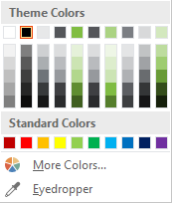
Slide Palette Info
The PowerPoint palette for this template has been built for you and is shown below. Avoid using too many colors in your presentation.
Select the 4th color from the left for subheads and 1st level non-bulleted text color, or wherever “color” text is preferred over the default black/white text
Accent colors 1-6 – (6 Theme Colors to the far right)
Text
Dark 2
Accent 1
Accent 2
Accent 3
Accent 4
Accent 5
Accent 6
Use Accent 1 as the main accent color. Use Accent 2 and Accent 3 when additional colors are needed.
Use Accents 4-6 sparingly – only when more colors are necessary.

Slide 6
Chart Example

Slide 7
Lots of data? Minimalize and Plan
Gray is used to de-emphasize data that is less important. Use cool gray 3 or cool gray 7. See slide 7 for color formulas.
All elements have the same interior margins as text blocks.
When a chart or graphic, has more elements than can easily be aligned to the grid, align the outer edges of the group, top, bottom, left and right edges to the grid.
It is preferable to keep the group aligned to the left border.
130M
140M
125M
Other
Other
Other
Other
Other
Other

Slide 8
Chart Example

Slide 9
Notes (hidden)
Some speakers like to use this slide for hidden “notes slides”.
Delete it if you don’t want to use it.

Slide 11


Slide 12





Slide 13
Power Platform. Potencia tus datos de forma rápida
Pedro Sánchez Naranjo

Slide 14



Pedro Sánchez Naranjo
Technology Team Leader en @bravent
Twitter @pjsanchezn
Miembro organizador de @dotnetfans_mlg

Slide 15
Objetivos
Conocer PowerApps
Crear una PowerApp
Conocer PowerBI
Crear informes en PowerBI
Conocer Power Automate
Integrar PowerBi con PowerApps y Power Automate
Publicación de informes de PowerBI

Slide 16

Agenda
Creación de primera PowerApp
Introducción a PowerBI
Integración de PowerApp con PowerBI
Analizando datos en PowerBI
Integración e PowerApp con Power Automate y PowerBi
Publicación de informes en PowerBI Service
Embedido de tus informes en una web

Slide 17
Conceptos PowerApp

Slide 18

Conceptos PowerApps
Agilidad para crear apps
Funcionalidad avanzada
Aplicaciones a medida
Adaptación a cualquier sector
Mejora de productividad

Slide 19




Casos Éxito

Slide 20
Creando tu primera PowerApp

Slide 21
Introducción a PowerBI

Slide 22
Introducción a PowerBI
Agilidad en creación de reports
Solución de análisis empresarial
Visualización de datos
Multitud de conectores a origenes de datos
Visuals y controles por defecto

Slide 23
Introducción a PowerBI
Marketplace de controles y visuals y Custom Visuals
Integración con otros servicios
Posibilidad de compartir los informes
Embedido en webs propias

Slide 24




Casos Éxito

Slide 25
Demo PowerBI

Slide 26
Demo Integración PowerBI y PowerApp

Slide 27
Power Automate

Slide 28
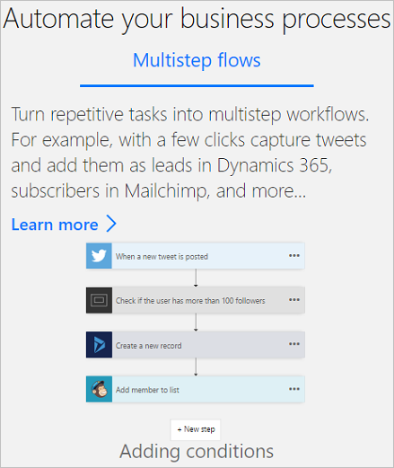
Introducción a Power Automate
Integración del análisis de datos con flujos de proceso
Se compone de:
Desencadenadores
Acciones
Conexiones

Slide 29
Tipos de flujo Power Automate
Flujos automatizados
Flujos de botón
Flujos programados
Flujos de proceso de negocio

Slide 30
Demo Integración con Power Automate

Slide 31
Publicación de informes PowerBI

Slide 32
PowerBi Embedded

Slide 33
Tipos de Embedded
Cuenta PowerBI PRO
PowerBI Embedded
PowerBI Pemium

Slide 34
Demo PowerBI Embedded

Slide 35
Any Questions?

Slide 36

Please fill out the survey! & Win Swags!!
https://www.powerplatformbootcamp.com/survey

Slide 37
Thank You For Attending

